Slide 1
Flexbox
Media query
transform
jquery
ajax

Slide 2
skipbar
header > logo
header > menu
header > links
main
footer

Slide 3
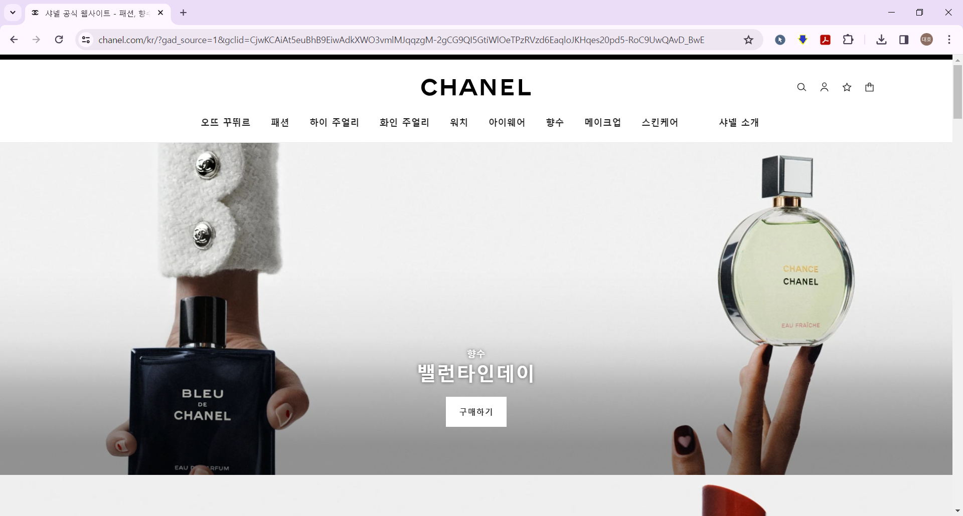
https://www.chanel.com/kr/

